Slide 1

Organizational intelligence technologies
There are three kinds of intelligence: one kind understands things for itself, the other appreciates what others can understand, the third understands neither for itself nor through others. This first kind is excellent, the second good, and the third kind useless.
Machiavelli, The Prince, 1513.

Slide 2
Organizational intelligence
Organizational intelligence is the outcome of an organization’s efforts to collect store, process, and interpret data from internal and external sources
Intelligence in the sense of gathering and distributing information

Slide 3
Types of information systems
Type of information system | System’s purpose
Transaction processing system TPS | Collects and stores data from routine transactions
Management information system MIS | Converts data from a TPS into information for planning, controlling, and managing an organization
Decision support system DSS | Supports managerial decision making by providing models for processing and analyzing data
Executive information system EIS | Provides senior management with information necessary to monitor organizational performance, and develop and implement strategies
On-line analytical processing OLAP | Presents a multidimensional, logical view of data to the analyst with no requirements as to how the data are stored
Data mining | Uses statistical analysis and artificial intelligence techniques to identify hidden relationships in data

Slide 4
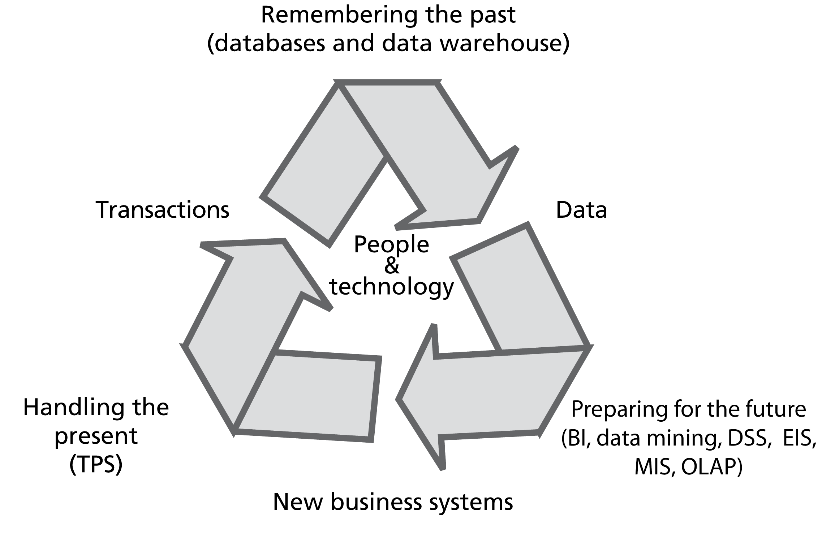
The information systems cycle

Slide 5
Transaction processing systems
Can generate huge volumes of data
A telephone company may generate 200 million records per day
Raw material for organizational intelligence

Slide 6
The problem
Organizational memory is fragmented
  Different systems
  Different database technologies
  Different locations
An underused intelligence system containing undetected key facts about customers

Slide 7
The data warehouse
A repository of organizational data
Can be measured in terabytes

Slide 8
Managing the data warehouse
Extraction
Transformation
Cleaning
Loading
Scheduling
Metadata

Slide 9
Extraction
Pulling data from existing systems
Operational systems were not designed for extraction to load into a data warehouse
Applications are often independent entities
Time consuming and complex
An ongoing process

Slide 10
Transformation
Encoding
  m/f, male/female to M/F
Unit of measure
  inches to cms
Field
  sales-date to salesdate
Date
  dd/mm/yy to yyyy/mm/dd

Slide 11
Cleaning
Same record stored in different departments
Multiple records for a company
Multiple entries for the same organization
Misuse of data entry fields

Slide 12
Loading
Archival
  May be too costly
Current
  From operational systems
Ongoing
  Continual updating of the warehouse

Slide 13
Scheduling
A trade-off
  Too frequent is costly
  Infrequently means old data

Slide 14

Metadata
A data dictionary containing additional facts about the data in the warehouse
  Description of each data type
  Format
  Coding standards
  Meaning
  Operational system source
  Transformations
  Frequency of extracts

Slide 15
Warehouse architectures
Centralized
Federated
Tiered

Slide 16
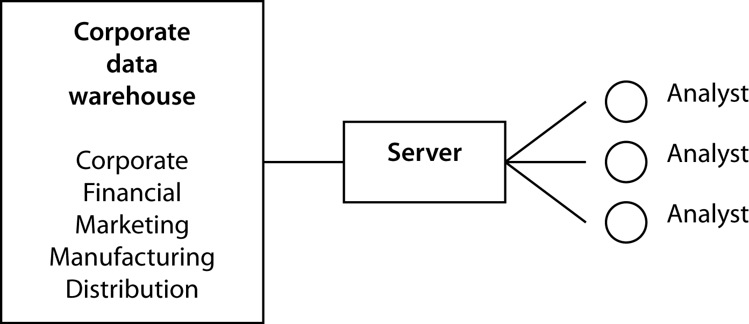
Centralized data warehouse

Slide 17
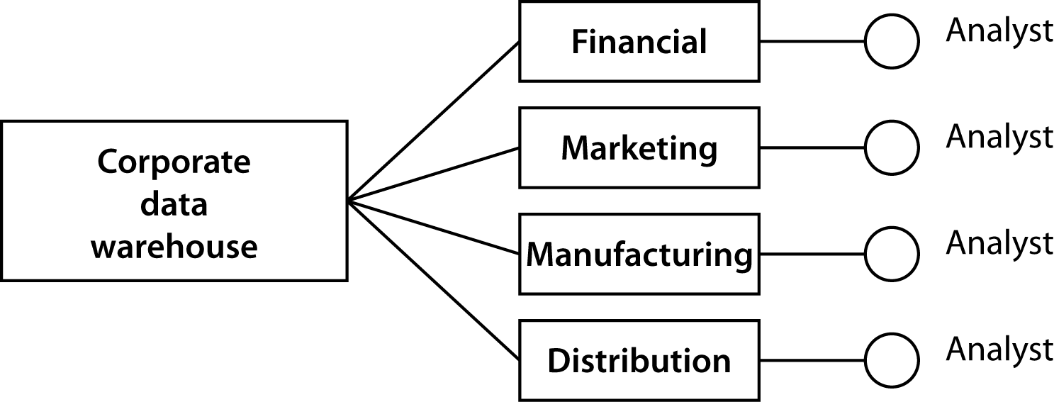
Federated data warehouse

Slide 18
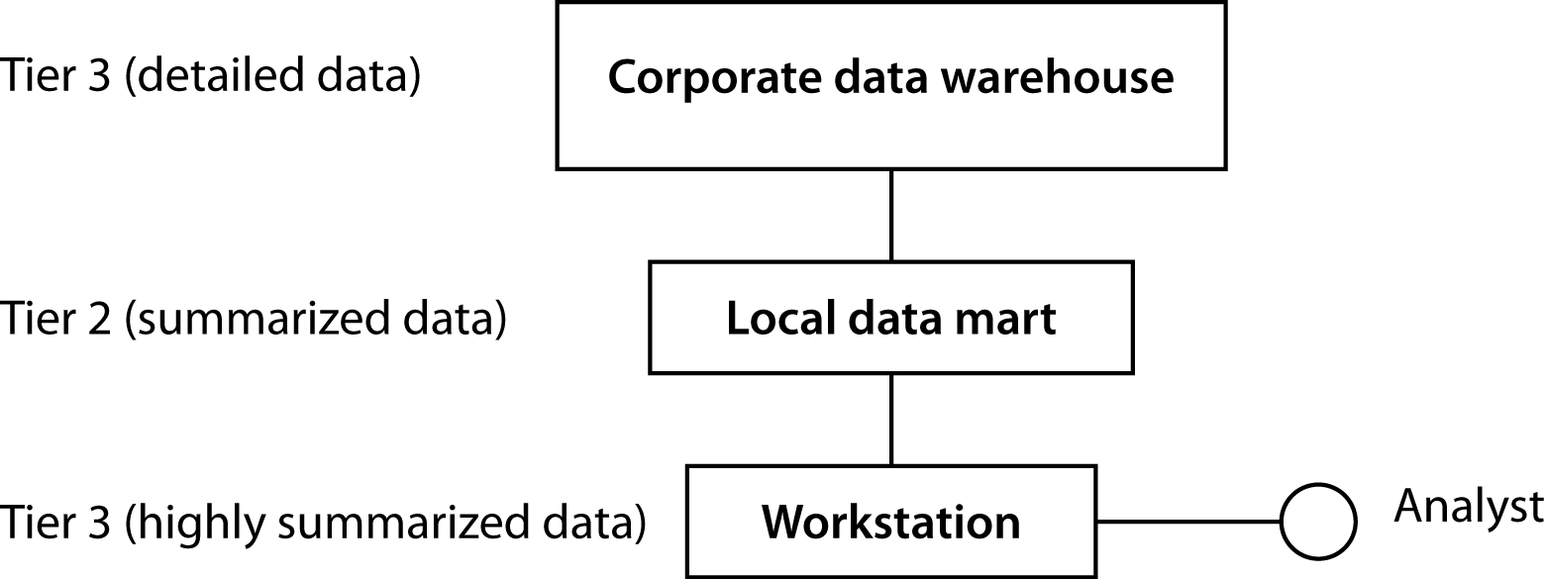
Tiered data warehouse

Slide 19
Server options
Single processor
Symmetric multiprocessor
Massively parallel processor
Nonuniform memory access

Slide 20
Single processor

Slide 21
Symmetric multiprocessor

Slide 22
Massively parallel processor

Slide 23
Nonuniform memory access

Slide 24
DBMS choices
Features/ functions | Relational | Super-relational | Multidimensional (logical) | Multidimensional (physical) | Object-relational
Normalized data structures | √ | √ |  |  | √
Abstract data types |  |  |  |  | √
Parallelism | √
Multidimensional structures |  | √ | √ | √
Drill-down |  |  | √ | √ | √
Rotation |  |  | √ | √ | √
Data-dependent operations |  |  |  |  | √

Slide 25
Decision matrix
For these environments … |  |  | Choose …
Business requirements | Client population | Systems support | Architecture | Server | DBMS
Scope: departmental Uses: data analysis | Small; Single location | Minimal local; average central | Consolidate; turnkey package | Single-processor or SMP | MDDB
Scope: departmental Uses: analysis plus informational | Large; analysis at single location; informational users dispersed | Minimal local; average central | Tiered; detail at central; summary at local | Clustered SMP for central; SP or SMP for local | RDBMS for central; MDDB for local
Scope: Enterprise Uses: analysis plus informational | Large; geographically dispersed | Strong central | Centralized | Clustered SMP | Object-relational Web support
Scope: departmental Uses: exploratory | Small; few sites | Strong central | Centralized | MPP | RDBMS with parallel support

Slide 26
The decision
Selection of a server architecture and DBMS are not independent decisions
Parallelism may be an option only for some RDBMSs
Need to find the fit that meets organizational goals

Slide 27
Exploiting data stores
Verification and discovery
Data mining
OLAP

Slide 28
Verification and discovery
Verification | Discovery
What is the average sale for in-store and catalog customers? | What is the best predictor of sales?
What is the average high school GPA of students who graduate from college compared to those who do not? | What are the best predictors of college graduation?

Slide 29
OLAP
Relational model was not designed for data synthesis, analysis, and consolidation
This is the role of spreadsheets and other special purpose software
Need to complement RDBMS technology with a multidimensional view of data

Slide 30
TPS versus OLAP
TPS | OLAP
Optimize for transaction volume | Optimize for data analysis
Process a few records at a time | Process summarized data
Real time update as transactions occur | Batch update (e.g., daily)
Based on tables | Based on hypercubes
Raw data | Aggregated data
SQL is widely used | MDX becoming a standard

Slide 31
ROLAP
A relational OLAP
A multidimensional model is imposed on a relational structure
Relational is a mature technology with extensive data management features
Not as efficient as OLAP

Slide 32
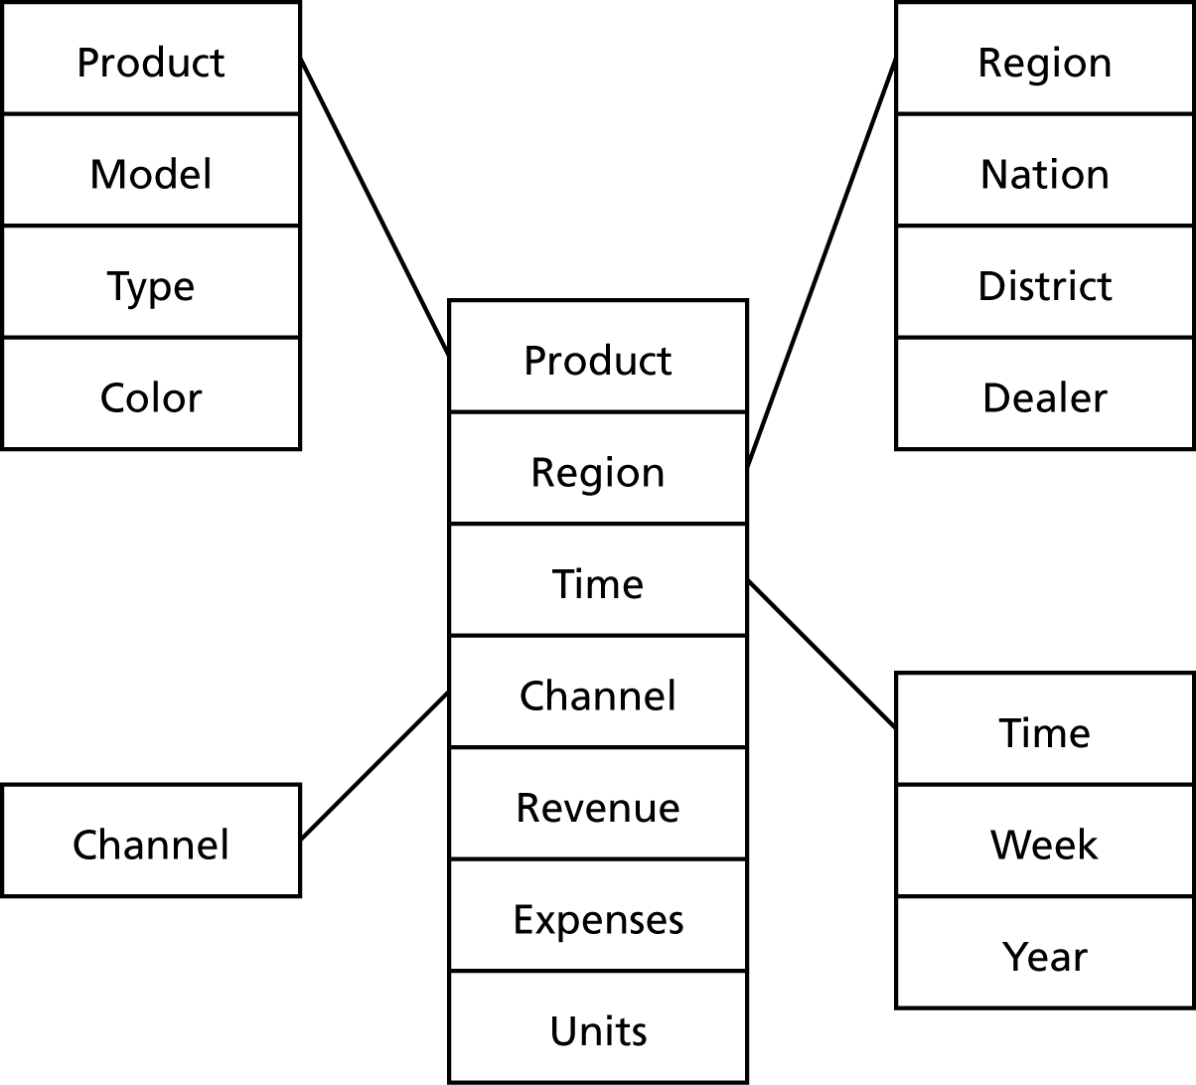
The star structure

Slide 33
The snowflake structure

Slide 34
Rotation

Slide 35
Drill down
Region | Sales variance
Africa | 105%
Asia | 57%
Europe | 122%
North America | 97%
Pacific | 85%
South America | 163%
Nation | Sales variance
China | 123%
Japan | 52%
India | 87%
Singapore | 95%

Slide 36
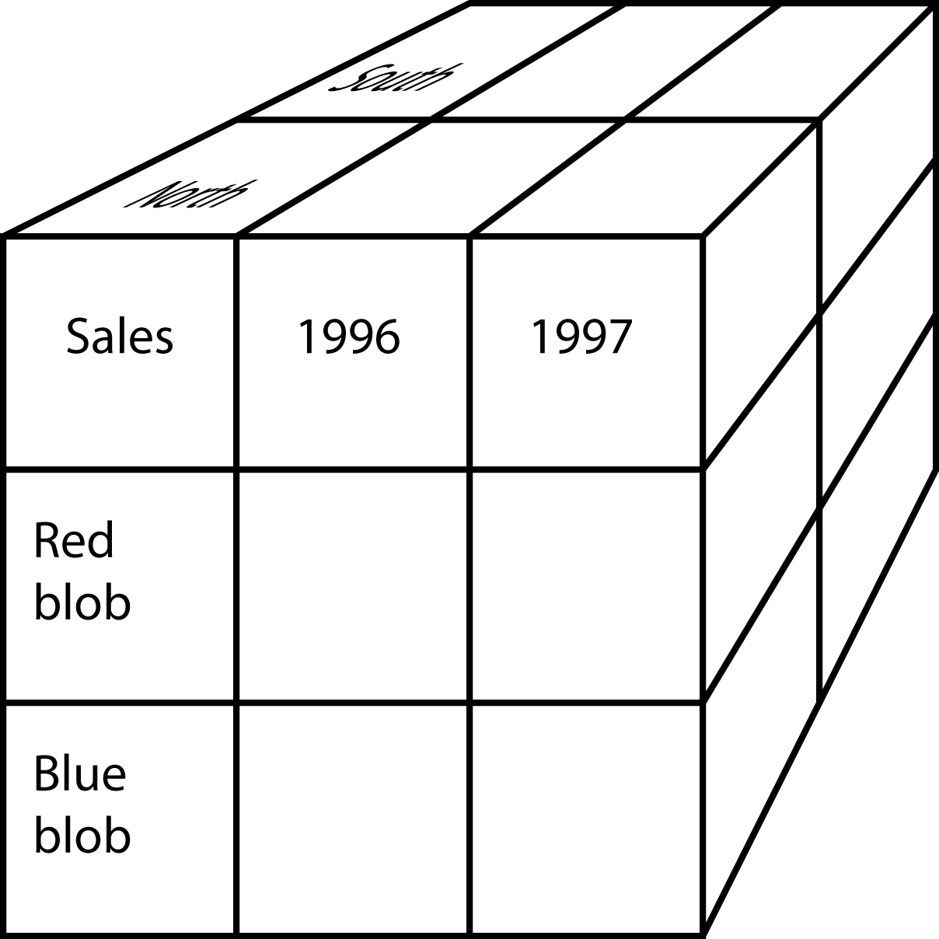
A hypercube

Slide 37
A three-dimensional hypercube display
Page |  |  |  |  | Columns
Region: North |  |  |  |  | Sales
 |  |  | Red blob | Blue blob | Total
 |  | 1996
Rows |  | 1997
Year |  | Total

Slide 38
A six-dimensional hypercube
Dimension | Example
Brand | Mt. Airy
Store | Atlanta
Customer segment | Business
Product group | Desks
Period | January
Variable | Units sold

Slide 39
A six-dimensional hypercube display
Page |  |  |  |  |  |  | Columns
Month Segment |  |  |  |  |  |  | Product group Variable
 |  | March | Business | Desks |  | Chairs
 |  |  |  | Units | Revenue | Units | Revenue
 |  | Carolina | Atlanta
 |  |  | Boston
Rows |  | Mt. Airy | Atlanta
Brand |  |  | Boston
Store |  | Totals

Slide 40
The link between
RDBMS and MDDB

Slide 41
MDDB design
Key concepts
  Variable dimensions
    What is tracked
      Sales
  Identifier dimensions
    Tagging what is tracked
      Time, product, and store of sale

Slide 42
Prompts for identifying dimensions
Prompt | Example
When? | June 5, 1998
Where? | Paris
What? | Tent
How? | Catalog
Who? | Young adult woman
Outcome? | Revenue of 6,000 FF

Slide 43
Variables and identifiers
Identifier time (hour) | Variable sales (dollars)
10:00 | 523
11:00 | 789
12:00 | 1,256
13:00 | 4,128
14:00 | 2,634
Identifier hit | Variable time (hh:mm:ss)
1 | 9:34:45
2 | 9:34:57
3 | 9:36:12
4 | 9:41:56

Slide 44
Analysis and variable type
 |  | Identifier dimension
 |  | Continuous | Nominal or ordinal
Variable dimension | Continuous | Regression and curve fitting Sales by quarter | Analysis of variance Sales by store
 | Nominal or ordinal | Logistic regression Customer response (yes or no) to the level of advertising | Contingency table analysis Number of sales by region

Slide 45
Data mining
The search for relationships and patterns
Applications
  Database marketing
  Predicting bad loans
  Detecting flaws in VLSI chips
  Identifying quasars

Slide 46
Data mining functions
Associations
  85 percent of customers who buy a certain brand of wine also buy a certain type of pasta
Sequential patterns
  32 percent of female customers who order a red jacket within six months buy a gray skirt
Classifying
  Frequent customers as those with incomes about $50,000 and having two or more children
Clustering
  Market segmentation
Predicting
  Predict the revenue value of a new customer based on that person’s demographic variables

Slide 47
Data mining technologies
Decision trees
Genetic algorithms
K-nearest neighbor method
Neural networks
Data visualization

Slide 48
SQL-99 and OLAP
SQL can be tedious and inefficient
The following questions require four queries
  Find the total revenue
  Report revenue by location
  Report revenue by channel
  Report revenue by location and channel

Slide 49
SQL-99 extensions
GROUP BY extended with
  GROUPING SETS
  ROLLUP
  CUBE

Slide 50
GROUPING SETS
SELECT location, channel,DECIMAL(SUM(revenue),9)
FROM exped
GROUP BY GROUPING SETS (location, channel);

Slide 51
GROUPING SETS
Location | Channel | Revenue
null | Catalog | 108762
null | Store | 347537
null | Web | 27166
London | null | 214334
New York | null | 39123
Paris | null | 143303
Sydney | null | 29989
Tokyo | null | 56716

Slide 52
ROLLUP
SELECT location, channel,DECIMAL(SUM(revenue),9)
FROM exped
GROUP BY ROLLUP (location, channel);

Slide 53
ROLLUP
Location | Channel | Revenue
null | null | 483465
London | null | 214334
New York | null | 39123
Paris | null | 143303
Sydney | null | 29989
Tokyo | null | 56716
London | Catalog | 50310
London | Store | 151015
London | Web | 13009
New York | Catalog | 8712
New York | Store | 28060
New York | Web | 2351
Paris | Catalog | 32166
Paris | Store | 104083
Paris | Web | 7054
Sydney | Catalog | 5471
Sydney | Store | 21769
Sydney | Web | 2749
Tokyo | Catalog | 12103
Tokyo | Store | 42610
Tokyo | Web | 2003

Slide 54
CUBE
SELECT location, channel,DECIMAL(SUM(revenue),9)
FROM exped
GROUP BY CUBE (location, channel);

Slide 55
CUBE
Location | Channel | Revenue
null | Catalog | 108762
null | Store | 347537
null | Web | 27166
null | null | 483465
London | null | 214334
New York | null | 39123
Paris | null | 143303
Sydney | null | 29989
Tokyo | null | 56716
London | Catalog | 50310
London | Store | 151015
London | Web | 13009
New York | Catalog | 8712
New York | Store | 28060
New York | Web | 2351
Paris | Catalog | 32166
Paris | Store | 104083
Paris | Web | 7054
Sydney | Catalog | 5471
Sydney | Store | 21769
Sydney | Web | 2749
Tokyo | Catalog | 12103
Tokyo | Store | 42610
Tokyo | Web | 2003

Slide 56
SQL OLAP extensions
Useful
Not as powerful as MDDB tools
Use CUBE as the default

Slide 57
Conclusion
Data management is an evolving discipline
Data managers have a dual responsibility
  Manage data to be in business today
  Manage data to be in business tomorrow
Data managers now need to support organizational intelligence technologies

